Slide 1

The power of combustion
How far can your car go?

Slide 2
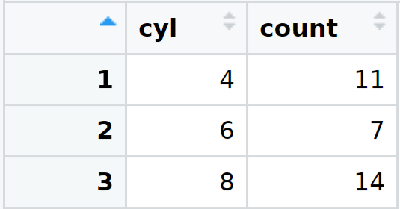
Testing 32 different style Cars ranging in Cylinder size Assuming random sampling:
Most makes are 8 cylinder at 43%
Half as many 6 cylinder are made at 21%
Close second is 4 cylinder at 34%
Why are there more 8 Cylinder car models?
sum.mpg.cyl=mtcars%>%group_by(cyl)%>% summarize(m.mpg=mean(mpg))
View(sum.mpg.cyl)

Slide 3
IS it because you get more miles per gallon?
Given the cylinders size=volume the bigger the size cylinder the more space/volume of gas will use. The cylinders should use the amount of gas at the same weight no matter the size.
Hypothesis: The cylinders use the same amount of gas per mile no matter the size cylinder.
Null Hypothesis: The cylinders gas per mile varies on the size of the cylinder.

Slide 4
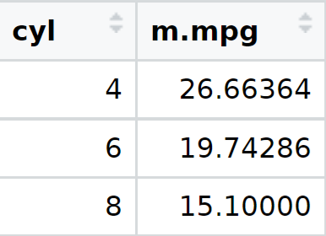
What is the average mile per GALLON
On average 4 cylinders cars lead 10 mpg more then 8 cylinders and yet more 8 cylinder cars are made. Rejecting my hypothesis
The smaller the cylinder the greater the horse power.
sum.mpg.cyl=mtcars%>%group_by(cyl)%>% summarize(m.mpg=mean(mpg))
View(sum.mpg.cyl)

Slide 5
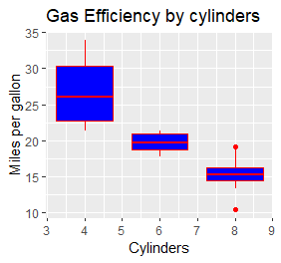
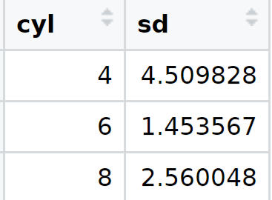
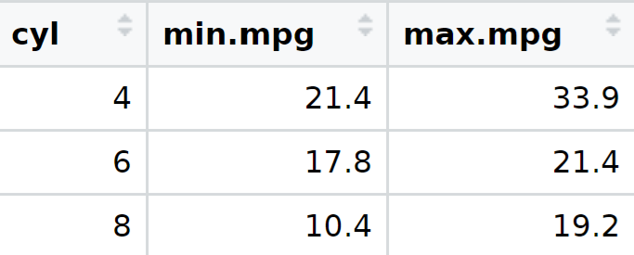
If we look at the difference in cylinders in a boxplot we can see:
that 4 cylinders has a large standard deviation.
mtcars.four=mtcars%>%select(cyl,mpg,hp)%>%
group_by(cyl)%>%
summarize(sd=sd(mpg))
View(mtcars.four)
6 cylinders seem to be about the same MPG with smaller deviation
8 cylinder has visible outliers
We can see that 8 cylinders can get up to 19mpg contending with 6 cylinders
min.max.cyl=mtcars%>%group_by(cyl)%>%summarize(min.mpg=min(mpg),max.mpg=max(mpg))
View(min.max.cyl)
mpg.cyl.plots=ggplot(mtcars,aes(x=cyl,y=mpg))+geom_boxplot(aes(group=cyl),color="red",fill="blue")+ggtitle("Gas Efficiency by cylinders")+xlab("Cylinders")+ylab("Miles per gallon")
mpg.cyl.plots

Slide 6

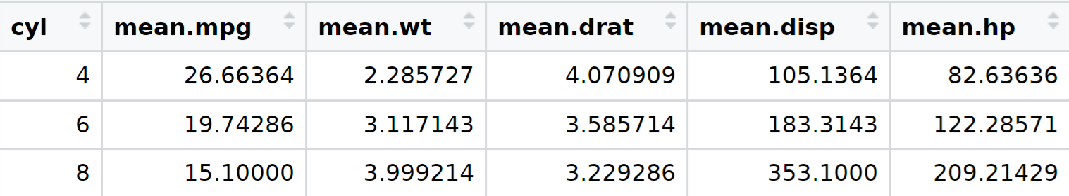
Taking a look at other reasons for 8 cylinder popularity
mean.cyl.info=mtcars%>%group_by(cyl)%>% summarize(m.mpg=mean(mpg),m.wt=mean(wt),drat=mean(drat),m.disp=mean(disp),m.hp=mean(hp))
View(mean.cyl.info)
When there is a high mean in HP there is a low mean in mpg .
The greater the HP the lower the miles per gallon.
HP and disp look comparable let us look at HP .

Slide 7
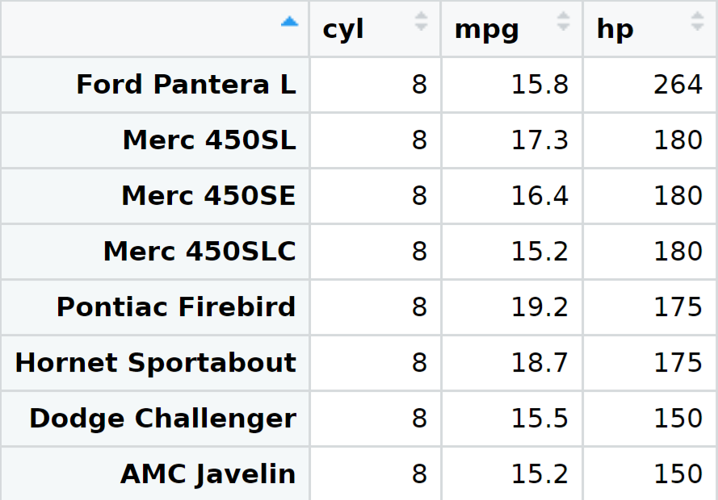
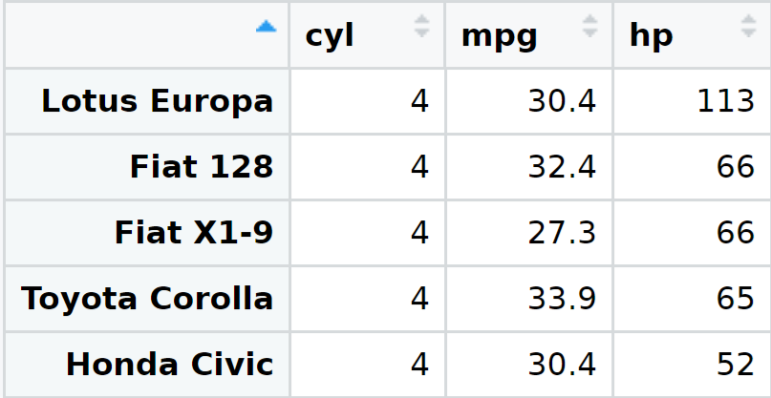
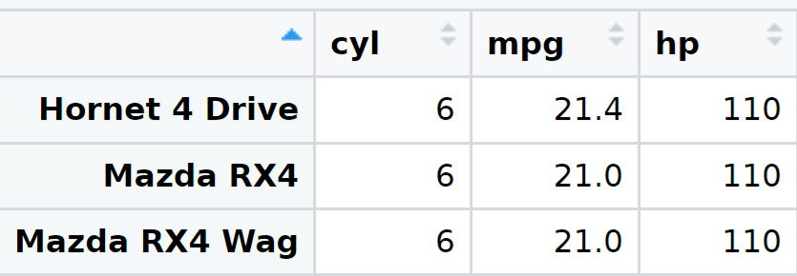
Conclusion
Miles per gallon Is not everything when choosing the right vehicle.
You can get more horse power and a reasonable miles per gallon form a 8 cylinder verse a 6 cylinder.
4 cylinders have great Miles per gallon and very few can put out the same amount of horse power.
best.eight=mtcars%>%select(cyl,mpg,hp)%>%
filter(cyl==8)%>%
filter(mpg>15.10000)%>%
arrange(desc(mpg))%>%
arrange(desc(hp))
View(best.eight)
best.four=mtcars%>%select(cyl,mpg,hp)%>%
filter(cyl==4)%>%
filter(mpg>26.66364)%>%
arrange(desc(mpg))%>%
arrange(desc(hp))
View(best.four)
best.six=mtcars%>%select(cyl,mpg,hp)%>%
filter(cyl==6)%>%
filter(mpg>19.74286)%>%
arrange(desc(mpg))%>%
arrange(desc(hp))
View(best.six)

